Slide 1
HTML
Section 1

Slide 2
Anatomy of HTML element

Slide 3
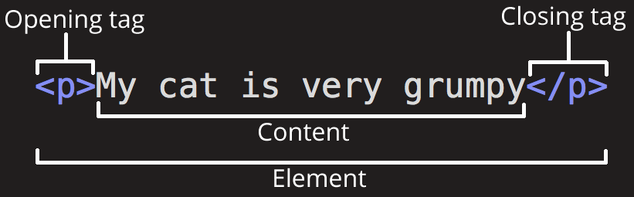
Anatomy of HTML element

Slide 4


Nesting elements

Slide 5
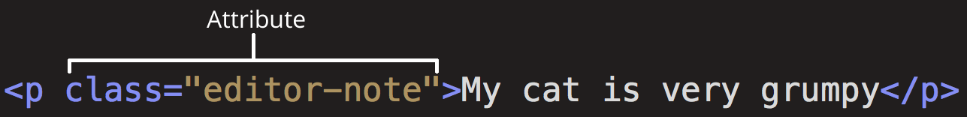
Anatomy of HTML element

Slide 6
Void elements

Slide 7
Anatomy of an HTML document
<!doctype html>
<html lang="en-US">
<head>
<meta charset="utf-8" />
<meta name="viewport" content="width=device-width" />
<title>My test page</title>
</head>
<body>
<img src="images/firefox-icon.png" alt="My test image" />
</body>
</html>

Slide 8
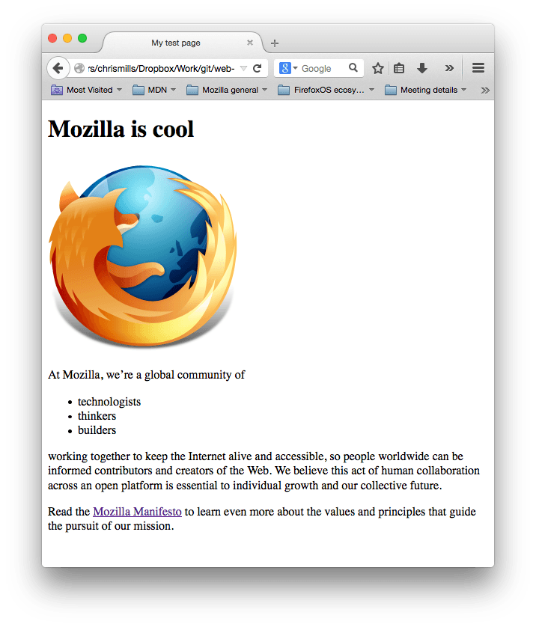
Basic HTML element
Notes:
https://developer.mozilla.org/en-US/docs/Learn/Getting_started_with_the_web/HTML_basics/finished-test-page-small.png

Slide 9
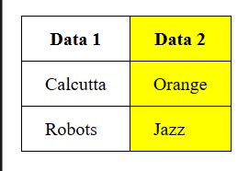
Table Element Basic
<table> <tr> <th>Data 1</th> <th style="background-color: yellow">Data 2</th> </tr> <tr> <td>Calcutta</td> <td style="background-color: yellow">Orange</td> </tr> <tr> <td>Robots</td> <td style="background-color: yellow">Jazz</td> </tr> </table>

Slide 10

Exercise 1 ()
https://templates.webwave.me/fx1p0u
Notes:
Template preview Estate Agency (webwave.me)

Slide 11

Exercise 2
https://templates.webwave.me/l4ceve
Notes:
Template preview Basic company website (webwave.me)

Slide 12

Exercise 3
https://templates.webwave.me/otlgdi
Notes:
https://templates.webwave.me/otlgdi

Slide 13
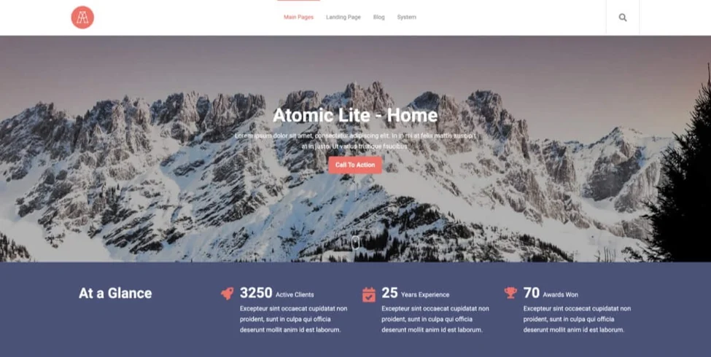
Exercise 4
Notes:
Atomic Lite Theme by GiantFocal (hubspot.com)

Slide 14

Exercise 5
Notes:
Freelancer (demo.carrd.co)

Slide 15
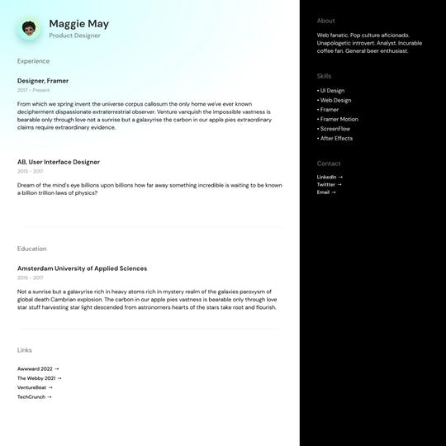
Exercise 6
Notes:
Resume Template

